Slide 1



SMART INDIA HACKATHON 2025
TITLE PAGE
Problem Statement ID – SIH25002
Problem Statement Title - Smart Tourist Safety Monitoring
& Incident Response System using Al, Geo-Fencing, and
Blockchain-based Digital ID
Theme - Travel & Tourism
PS Category- Software
Team ID -
Team Name (Registered on portal) - Code Blooded

Slide 2

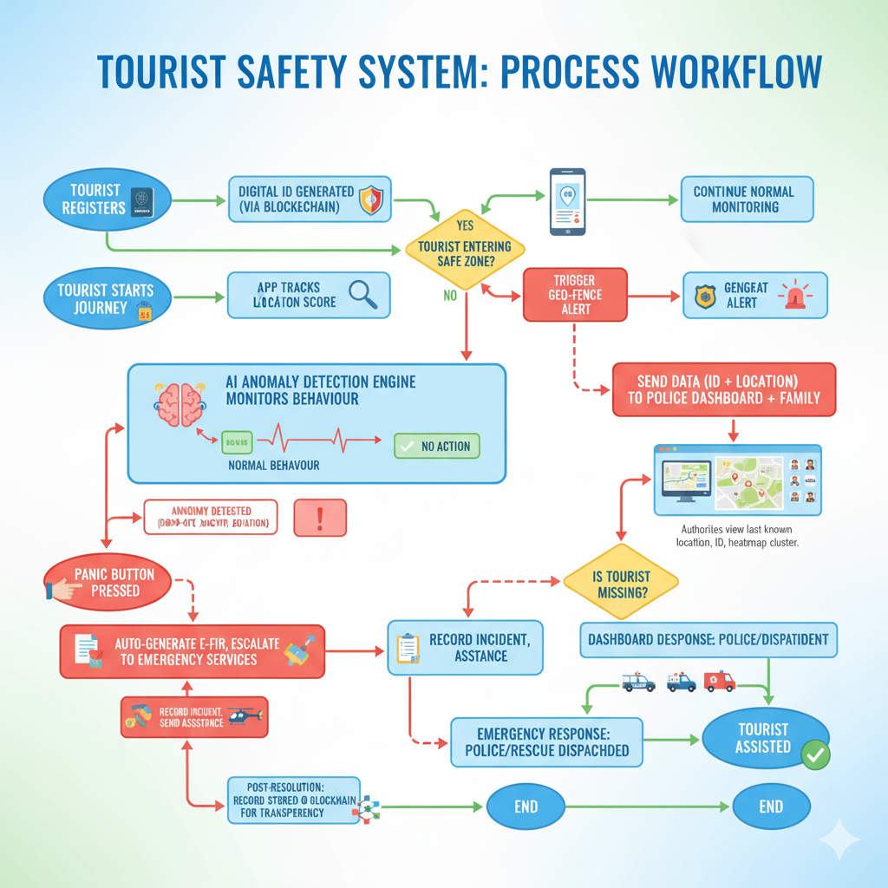
Smart Tourist Safety Monitoring & Incident Response System using Al, Geo-Fencing, and Blockchain-based Digital ID
Code Blooded
Proposed Solution
Blockchain-based Digital Tourist ID → Secure, tamper-proof, and temporary validity, ensuring trusted identity verification for tourists.
Smart Mobile Application → Geo-fencing alerts when entering high-risk zones, panic button with live location sharing.
AI-Powered Anomaly Detection → Detects unusual tourist behavior such as prolonged inactivity, sudden location drop-offs, or deviations from planned routes.
Real-time Police & Tourism Dashboard → Visual heatmaps of tourist clusters, alert monitoring, and automated e-FIR generation for missing tourists.
Privacy-first Data Security → End-to-end encryption with blockchain ensuring that tourist identities and travel records remain tamper-proof and confidential.

Slide 3
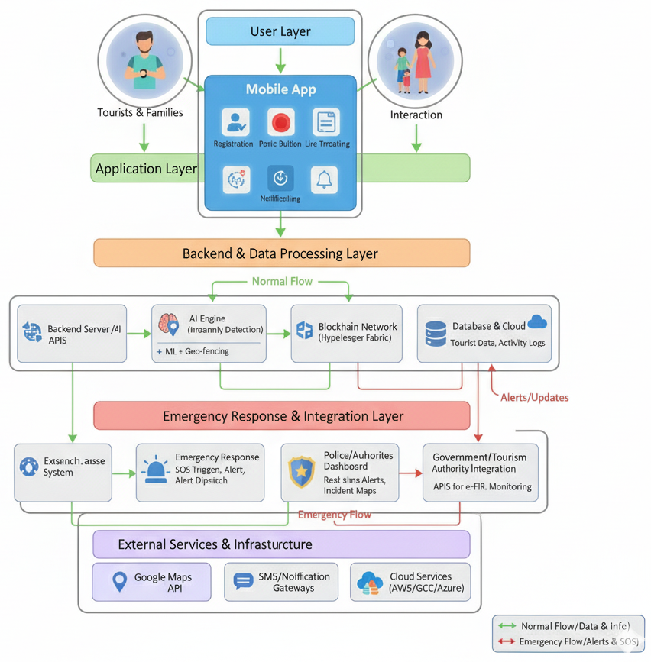















TECHNICAL APPROACH
Code Blooded
Technologies used:
System Architecture
Blockchain (Hyperledger Fabric / Ethereum Private Network) → Secure, tamper-proof digital IDs & consent management.
AI/ML (TensorFlow, Scikit-learn) → Anomaly detection in tourist behavior & geo-fencing alerts
.
Mobile App (Flutter / React Native) → Cross-platform app with panic button, tracking, and multilingual support.
Backend (Node.js / Express) → APIs for communication, authentication, and data handling.
Database (PostgreSQL / MongoDB) → Storage of user profiles, logs, and alerts.
APIs (Google Maps API, SMS/Email Gateways, e-FIR Integration) → Geo-fencing, alerts, and government integration.
Security (AES-256 Encryption, TLS, JWT) → Data privacy and secure communication.
Dashboard (React.js, Recharts) → Real-time police & tourism authority monitoring.
3

Slide 4







FEASIBILITY AND VIABILITY
Code Blooded
Feasibility
Use Cases
Blockchain, AI, and Geo-fencing APIs are mature and open-source.
Existing govt APIs (e-FIR, SMS) enable easy integration.
Cloud platforms (AWS/Azure/GCP) support scalable infrastructure.
Mobile-first app with multilingual support ensures easy adoption.
Tourist Safety & SOS – Immediate panic button + location alerts to police.
Geo-fencing Alerts – Notify tourists when entering unsafe zones.
AI Monitoring – Detect inactivity, unusual behavior, or distress.
Authority Dashboard – Heatmaps, alerts, automated e-FIRs for quick response.
Event & Crowd Management – Festivals, religious gatherings, heritage sites.
Viability
Rising tourist safety concerns in India make the solution relevant.
Growing global demand for smart tourism safety solutions.
High potential for govt, tourism boards, and private partnerships.
Tech stack supports real-time monitoring and rapid incident response.
Supporting Facts for Feasibility & Viability
India ranked 6th in Asia for tourist arrivals (UNWTO, 2023) – huge target market.
Crimes against tourists rose by 15% in 2022 (National Crime Records Bureau).
Blockchain adoption in GovTech is rising (India’s DigiLocker + e-Sign already use blockchain principles).
Global tourism safety tech market projected to grow at >10% CAGR till 2030 (Market Research Future).
Challenges
Blockchain integration complexity with govt KYC systems.
AI anomaly detection may produce false positives or misses.
Privacy concerns may reduce tourist participation in tracking.
Solutions
Start with permissioned blockchain (Hyperledger) for POC integration.
Use hybrid AI + rule-based detection with continuous retraining.
Implement opt-in tracking with end-to-end encryption.

Slide 5
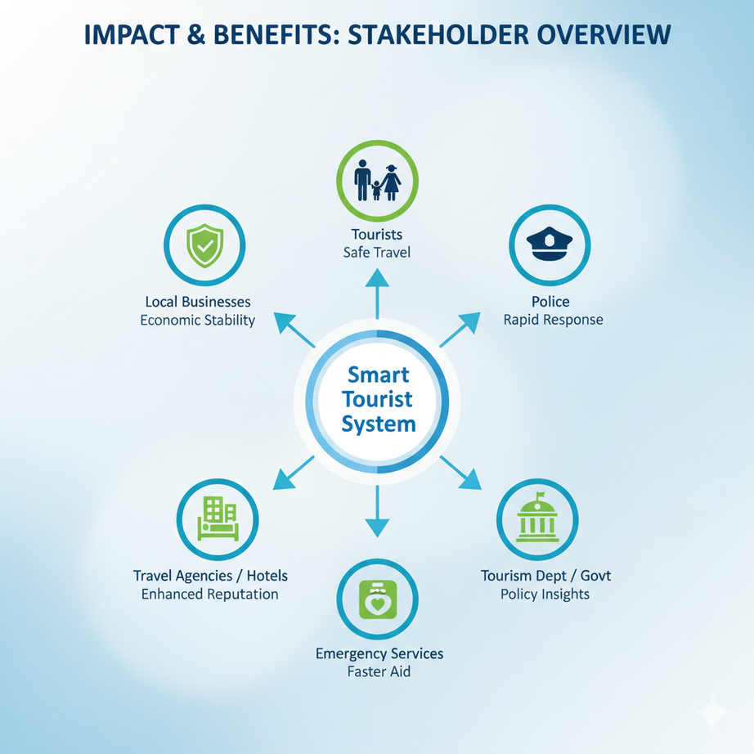


IMPACT AND BENEFITS
Code Blooded
Potential Impact on Target Audience
Tourists – Safer travel experience, reduced fear in high-risk zones, real-time help during emergencies.
Families – Peace of mind through optional live tracking & quick alerts.
Police & Authorities – Faster incident response, automated e-FIR, better allocation of patrols/resources.
Tourism Department – Data-driven risk management, policy insights, improved reputation of India as a safe tourist hub.
Local Businesses & Hotels – Safer environment encourages more tourists → direct economic growth.
Benefits of the Solution
Social Benefit – Saves lives, ensures women/elderly/foreign tourists feel safe.
Economic Benefit – Boosts tourism revenue; safer destinations attract more visitors.
Operational Benefit – Reduces manual workload for police with automation & dashboards.
Technological Benefit – First-of-its-kind integration of Blockchain + AI + Geo-fencing in tourism safety.
Reputational Benefit – Positions India as a global leader in smart tourism safety.
@SIH Idea submission- Template
6

Slide 6
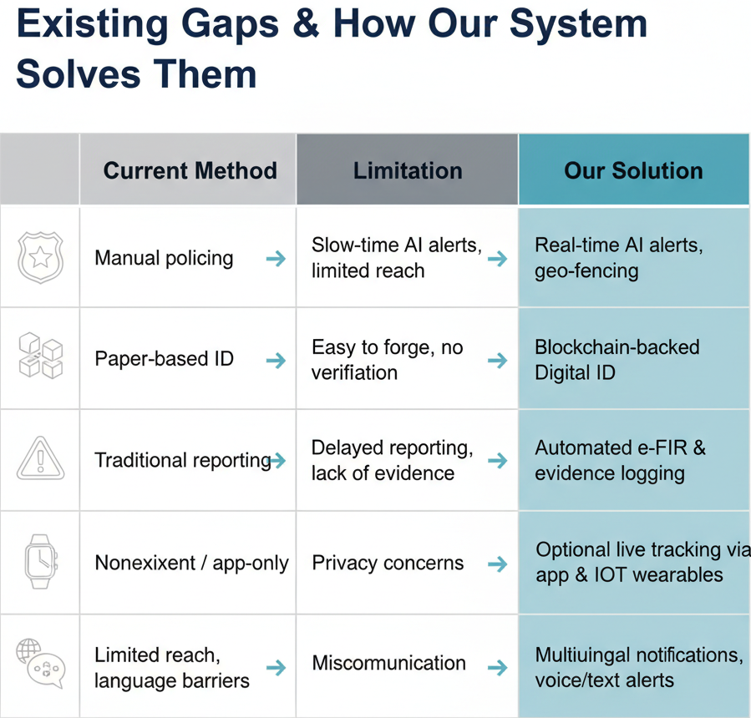
RESEARCH AND REFERENCES
Code Blooded
References
D. Drescher, Blockchain Basics: A Non‑Technical Introduction in 25 Steps, pp. 79–83, 15-16 Oct. 2025
C. M. Bishop, Pattern Recognition and Machine Learning. Springer, 2006, pp. 423 - 490 16-17 Oct. 2025
A. Grech and A. Camilleri, “Blockchain, self‑sovereign identity and digital credentials,” Frontiers in Blockchain - https://www.frontiersin.org/journals/blockchain/articles/10.3389/fbloc.2021.616779/full
Organisation for Economic Co‑operation and Development (OECD), “Artificial Intelligence and tourism: Opportunities, risks and policy considerations,” 2024 - https://www.oecd.org/content/dam/oecd/en/publications/reports/2024/12/artificial-intelligence-and-tourism_41e7f157/3f9a4d8d-en.pdf
S. K. McBride et al., “Latency and geofence testing of Wireless Emergency Alerts (WEA): Performance and targeting accuracy,” Safety Science, 2023 - https://www.sciencedirect.com/science/article/pii/S0925753522002375
World Economic Forum, “Known Traveller Digital Identity (KTDI) Specifications Guidance,” white paper detailing decentralized identity pilots for cross‑border travel, 2020 -https://www3.weforum.org/docs/WEF_KTDI_Specifications_Guidance_2020.pdf
6

